Slide 1

Dayananda Sagar College of Engineering
An Autonomous Institute affiliated to Visvesvaraya Technological University (VTU),
Approved by AICTE and UGC, Accredited by NAAC with 'A' grade & NBA,
ISO 9001-2015 Certified Institution
Presented to you By:
Pavan Kumar – 1DS24CG037
Parth Sahni – 1DS24CG034
Harvi Patel – 1DS24CG035
Ganesh V Patil – 1DS24CG014

Slide 2

Baymax: Your Personal AI Healthcare Companion
Baymax is a web-based AI healthcare companion designed to support mental well-being. It offers interactive features for a holistic approach to mental health.

Slide 3
Comprehensive Mental Wellness Support
Interactive Chat
Mood & Sleep Tracking
Guided Exercises
Personal Journal
Real-time AI/rule-based chat
Breathing patterns (Box, 4-7-8)
Daily entry with prompts
Daily mood logging
Avatar customization
Weekly mood calendar
Animated breathing circle
Word count feature
Emoji and voice input
Sleep quality logging
Recent entry history
Customizable sessions

Slide 4
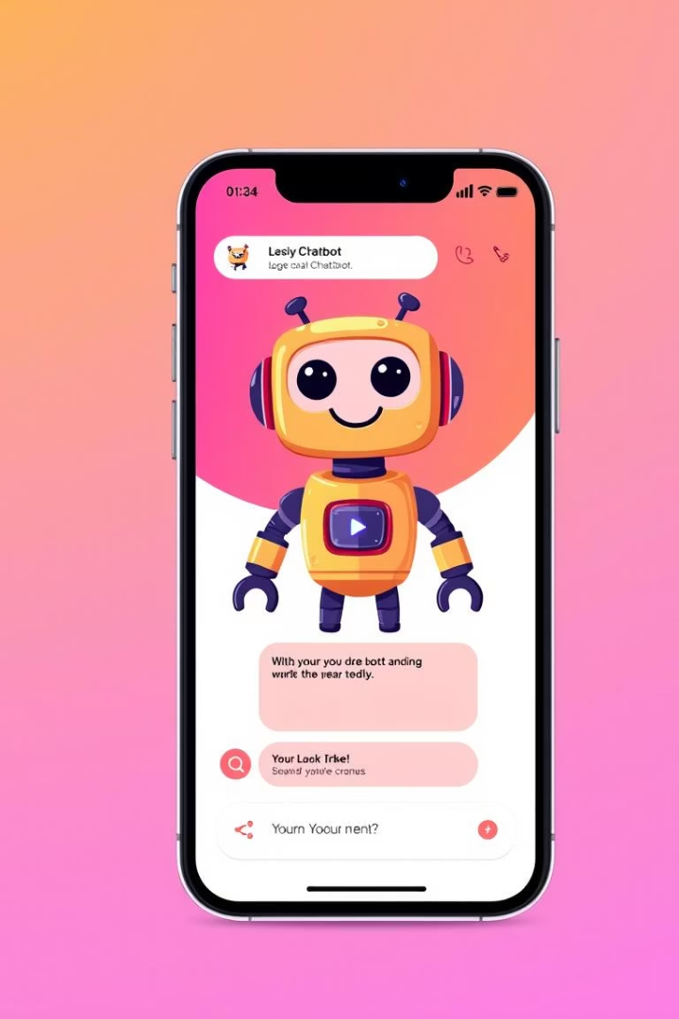



Empathetic Chatbot Interface
AI-Powered Companion
Personalized Avatar
Voice Input Option
Engage in real-time conversations with Baymax, your AI confidant.
Customize Baymax's avatar to reflect your current mood.
Communicate naturally using voice input for seamless interaction.
The chatbot offers an intuitive and personalized experience, making interactions feel natural and supportive.

Slide 5
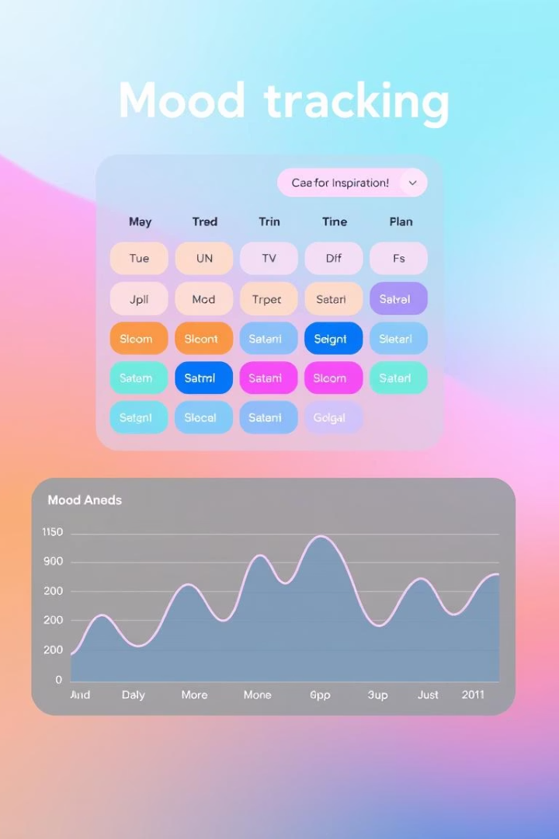



Track and Visualize Your Mood
Daily Mood Logging
Weekly Calendar View
Easily log your mood using a simple slider mechanism.
Visualize your mood patterns over time with a weekly calendar.
Performance Statistics
View average mood, streaks, and identify your best mood days.
Understand your emotional landscape better through insightful tracking and visualization.

Slide 6




Harness the Power of Breath
Guided Breathing
Follow guided patterns like Box or 4-7-8 breathing.
Animated Visuals
Use an animated circle to synchronize your breathing.
Customizable Sessions
Adjust duration and breathing patterns to suit your needs.
Breathing exercises help reduce stress and improve focus.

Slide 7
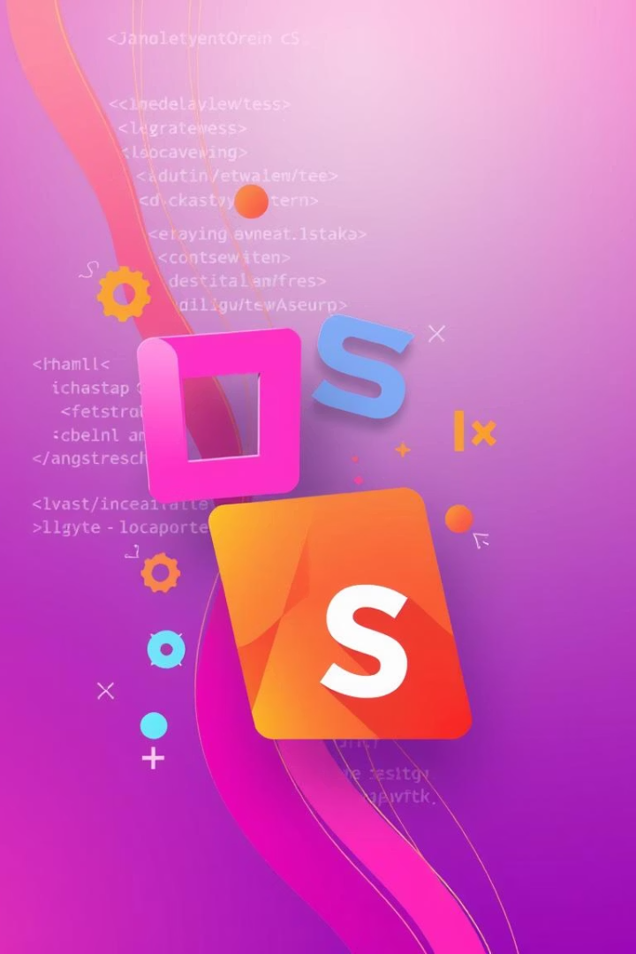
Key Technical Foundations
Modular HTML5
Semantic and maintainable structure for robust development.
CSS3 Theming
Custom properties enable easy light/dark mode transitions.
JavaScript Interactivity
Dynamic UI with tab navigation, modals, and sliders.
LocalStorage Persistence
User data for mood, sleep, and journal entries is saved locally.
Baymax is built on a solid, modern web stack for optimal performance and user experience.

Slide 8

Privacy-First Approach
1
0
24/7
Local Data Storage
No User Accounts
Emergency Access
All personal data resides on your device, not in the cloud.
Enjoy full privacy; no authentication or registration is required.
Crisis resources are always readily available and accessible.
Baymax prioritizes your privacy, ensuring your mental health journey remains confidential and secure.

Slide 9








Next Steps and Future Vision
Smarter AI Integration
Reminders & Notifications
Integrating advanced NLP APIs for enhanced chat capabilities.
Adding PWA support for personalized reminders.
Enhanced Accessibility
Data Management
Improving localization and accessibility features for all users.
Allowing users to export and import their personal data.
We are committed to continuously improving Baymax, adding new features to support your mental well-being even further.

Slide 10
Business Plan and Scalability
Business Plan: Baymax's Strategic Growth
Scalability: Ensuring Future Growth
Target Market: Individuals seeking accessible and private mental wellness support, especially those comfortable with AI and digital tools.
Technical Scalability: Leverage efficient HTML5, CSS3, and JavaScript practices for a lightweight and responsive application. LocalStorage ensures client-side data handling, reducing server load. Future PWA features will enhance distribution and engagement.
Value Proposition: Empathetic AI companionship, mood tracking, guided breathing, and crisis resources in a secure, privacy-first environment.
AI Integration: Modular integration of advanced NLP APIs allows for seamless upgrades to AI capabilities without overhauling the core application, enabling smarter and more personalized interactions.
Monetization Strategy: Explore premium features (e.g., advanced AI capabilities, personalized insights, extended guided content) through a subscription model, while maintaining a robust free tier for core functionalities.
Content Expansion: Design the content delivery system to easily add new guided breathing exercises, therapeutic modules, and educational resources. This supports continuous value addition without complex structural changes.
Marketing Channels: App store optimization, mental health community partnerships, content marketing (blog, social media on mental wellness), and user testimonials.
User Adoption: Focus on user experience and accessibility to drive organic growth. The no-account, local-data model removes friction for new users, making adoption straightforward and increasing retention.

Slide 11

Thank You
We appreciate your time and attention to Baymax, your AI therapist companion. We are excited about the future of mental wellness and hope Baymax can be a valuable tool for many. For any questions or further discussion, please feel free to reach out.

